Slide 1
Title: Drone Hacking: Signal Interference, Hijacking, and GPS Spoofing
Internship: Cybersecurity Internship 2025
Institution: Mulund College of Commerce (Autonomous)
Partner Organizations: Digisuraksha Parhari Foundation, Infinisec Technologies
Presented by: Laxmi Gupta, Snehal Patel

Slide 2
Abstract
Drones are widely used in logistics, defense, agriculture, and surveillance
Increased usage leads to increased cybersecurity vulnerabilities
Focus on signal interference, GPS spoofing, and hijacking
Research based on simulation, case studies, and open-source tools
Aim: Understand threats and propose mitigation strategies

Slide 3
Problem Statement
Drones operate on insecure protocols (Wi-Fi, GPS)
Susceptible to jamming, spoofing, and hijacking attacks
Weak encryption or default credentials in many models
Real-world examples of drone capture and crashes
Lack of international drone cybersecurity standards

Slide 4
Research Objectives
Identify technical methods for drone attacks
Analyze open-source hacking tools
Study real-world drone breach cases
Evaluate risk impact across sectors
Recommend security measures and solutions

Slide 5
Literature Review
GPS spoofing via SDR demonstrated by Kerns et al.
Phantom attack used rogue Wi-Fi to hijack DJI drones
Iran spoofed U.S. military drone (RQ-170) in 2011
SkyJack drone attack via MAC deauth packets
Maldrone malware for Linux-based drone control

Slide 6
Research Methodology
Qualitative, secondary research from published sources
Simulated GPS spoofing via Python plotting
Evaluated attack tools: SkyJack, Wireshark, WiFiPhisher
Classified attacks: interference, hijacking, spoofing
Observed attack feasibility with low-cost hardware

Slide 7
TOOL:GPS Spoofing Simulation Tool
import random
import matplotlib.pyplot as plt
# Real path (straight line)
real_path = [(x, 50) for x in range(100)]
# Spoofed path (altered by attacker)
spoofed_path = [(x, 50 + random.uniform(-10, 10)) for x in range(100)]
# Plotting both paths
x_real, y_real = zip(*real_path) x_spoof, y_spoof = zip(*spoofed_path) plt.plot(x_real, y_real, label="Real GPS Path", color="green")
plt.plot(x_spoof, y_spoof, label="Spoofed GPS Path", color="red", linestyle="--") plt.legend()
plt.title("GPS Spoofing Simulation")
plt.xlabel("Longitude")
plt.ylabel("Latitude")
plt.grid(True)
plt.show()

Slide 8
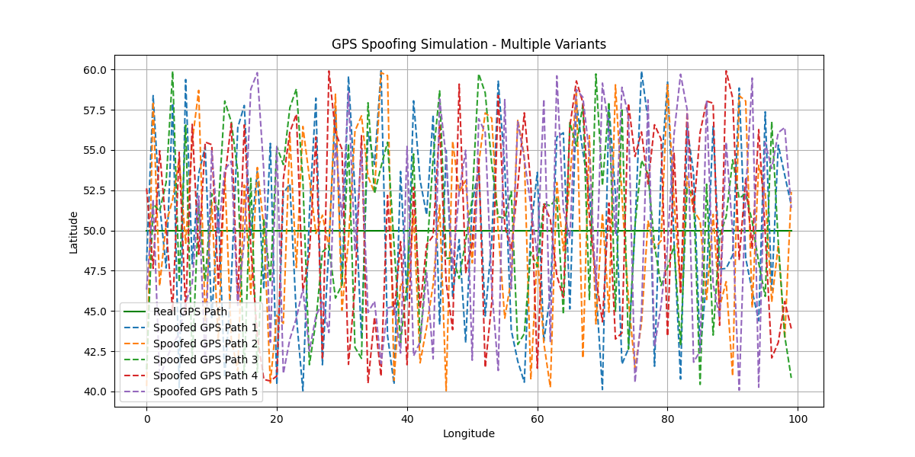
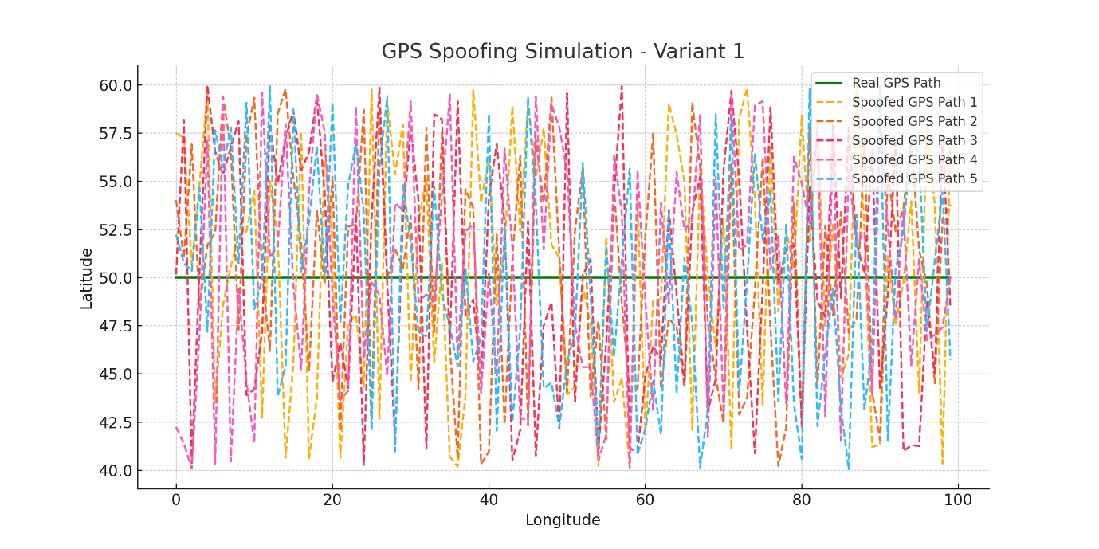
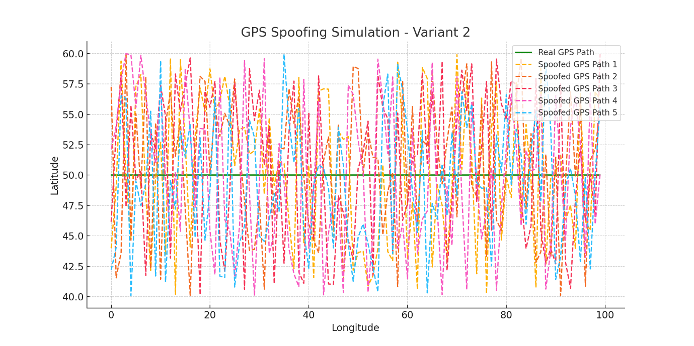
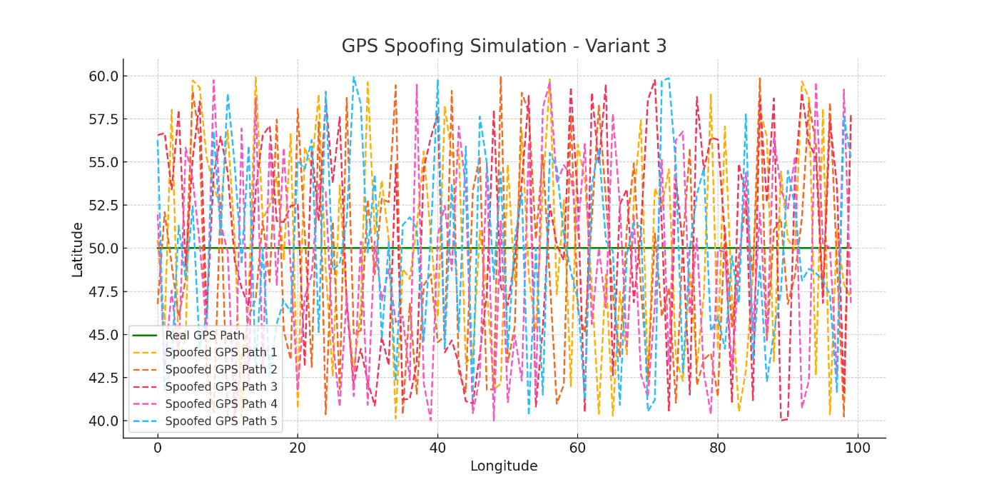

Slide 9
Attack Simulations
GPS Spoofing:
→Python simulated original vs spoofed path
→Drone misdirection observed in map plot
Hijacking:
→Used deauth to disconnect pilot
→Reconnected and issued commands via attacker device
Tools required minimal setup and succeeded repeatedly

Slide 10
Results & Observations
Signal interference disrupted control up to 30m range
GPS spoofing changed drone’s flight by 30–50 meters
Hijacking via Wi-Fi successful on drones with no password
Many drones lacked encryption, 2FA, or MAC filtering
Open-source tools allowed repeatable attack scenarios

Slide 11
Market Relevance & Ethical Impact
Drone market projected to reach $70B by 2030
Hacked drones can breach privacy or carry threats
Tools pose dual-use dilemma (research vs misuse)
Legal issues in simulating real attacks
Public safety concerns with rogue or hijacked drones

Slide 12
Future Scope
AI for anomaly detection in drone behavior
Blockchain for secure drone identity and communication
GNSS spoofing detection using satellite triangulation
Anti-drone measures: radar, jammers, drone interceptors
Regulatory need: encrypted comms, firmware updates, usage policy

Slide 13
.
Thank you !!

